Slide 1

Hiring shouldn't feel like drowning in PDFs
Small and mid-sized companies face an impossible challenge: hundreds of resumes pour in for every open role, but there's no time or tools to review them properly. The result? Hiring drags on for months, critical positions stay unfilled, and exceptional candidates slip through the cracks while you're still buried in spreadsheets.
The Volume Problem
The Time Crunch
The Talent Loss
Top candidates accept other offers while you're still screening batch one
200+ resumes per role on average, each requiring 5-10 minutes of careful review
Small teams juggle hiring alongside their day jobs, leading to rushed decisions

Slide 2
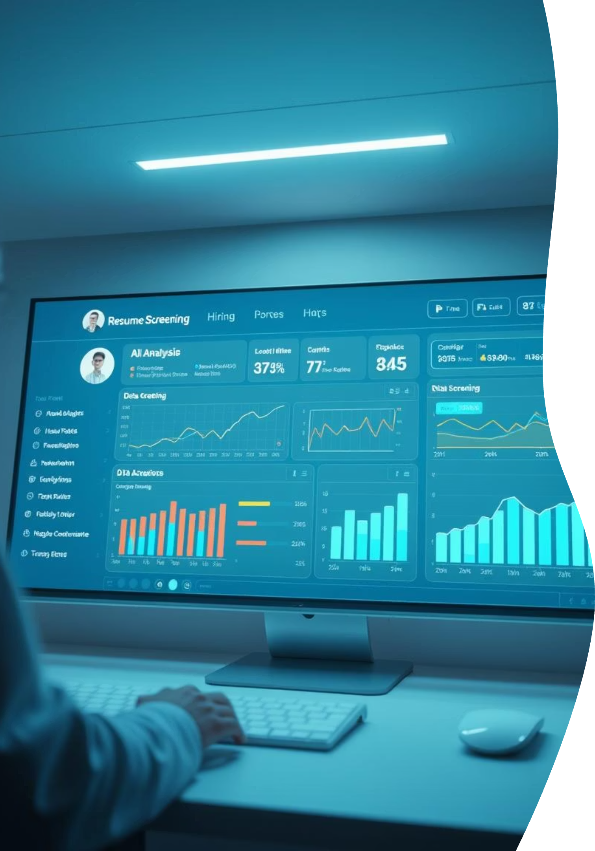
A massive, underserved hiring problem
The Market
Why Now
Millions of SMBs hire every year without dedicated recruiting teams
Existing ATS tools are built for enterprises, not founders or lean teams
Manual screening increases time-to-hire and decision fatigue
Even small delays cause top candidates to drop out
LLMs can finally reason over unstructured resumes
Agentic AI enables decisions and actions, not just insights

Slide 3



The Real Problem: Decision-Making Under Cognitive Overload
Sarah – Founder / Talent Manager
Sarah is the Founder and Talent Manager at a 50-person tech company. She wears many hats, and recruiting is just one of them. She needs to hire top talent efficiently to keep her company growing, but the process is overwhelming.
200–500 resumes per role
Inconsistent, mentally exhausting screening
The sheer volume of applications makes initial screening a daunting task.
Manually reviewing each resume leads to burnout and biases.
Fear of missing high-quality candidates
Manual scheduling and follow-ups slow everything down
She worries that excellent fits are being overlooked in the pile.
Administrative tasks consume valuable time that could be spent on strategic work.
The real problem isn't resume parsing — it's decision-making under cognitive overload.

Slide 4

Recruit-AI: Your Tireless Junior Recruiter
An agentic AI that automates resume screening and interview scheduling for small teams.
How It Works
01
Upload Job Description + Resume(s)
02
AI evaluates candidate fit
03
Generates comprehensive report
Match score (0–100)
Clear reasoning
Recommended action (Interview / Reject / Hold)
04
Automatically drafts emails or schedules interviews
Like a junior recruiter who never gets tired.

Slide 5
The Prototype: What Users See
Core User Flow
Why This Matters
01
Fast
Explainable
Confidence-building, not "black box AI"
Upload Job Description
02
Upload Resume
03
View AI analysis:
Fit score
Strengths & gaps
Recommendation

Slide 6
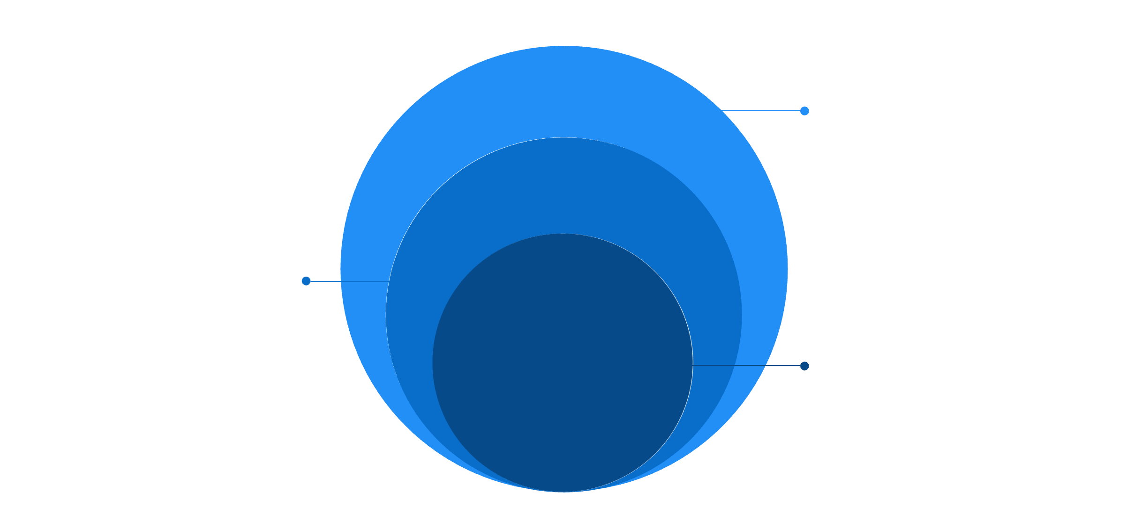

Technical Architecture: How It Works
Integrations
Email drafting and calendar scheduling
Backend
n8n agent workflow and LLM reasoning
Frontend
Simple web UI for uploads & results
1
2
3
Frontend Layer
Backend Layer
Extention Apps
Simple web UI for uploads & results, providing an intuitive user experience.
Powers the core logic:
Extends functionality with external services:
Agent workflow (n8n) for orchestrating tasks
LLM: Resume + JD reasoning engine for intelligent analysis
Email drafting
Calendar scheduling (simulated or real)
Modular, explainable, and easy to extend.

Slide 7

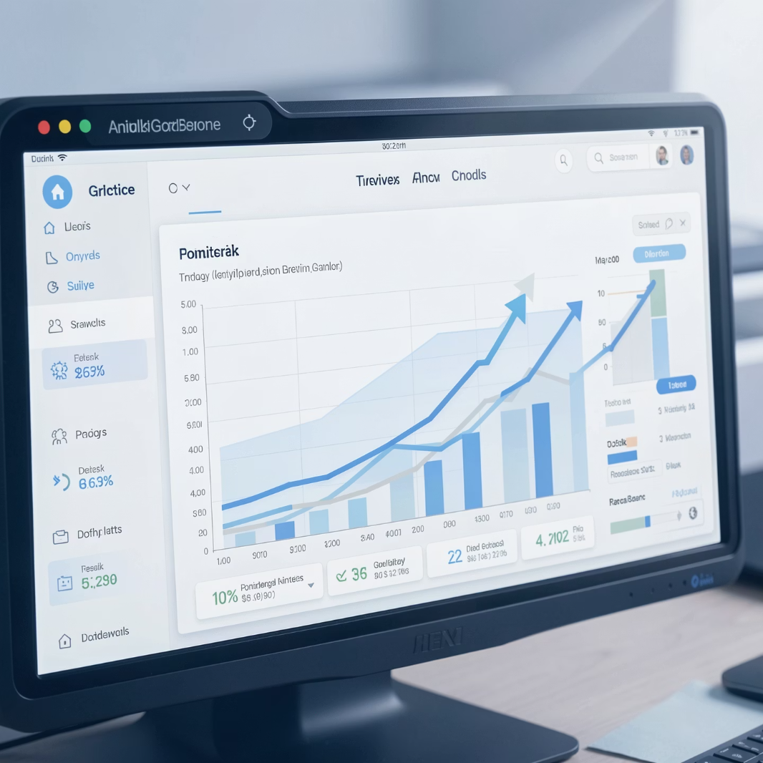

Roadmap, Metrics & Vision
6-Month Roadmap
Success Metrics
Long-Term Vision
Batch resume uploads
Calendar integration
Recruiter feedback loop
ATS export
Time-to-screen reduced by 40–60%
Faster interview scheduling
Higher recruiter confidence
Become the hiring intelligence layer for SMBs - starting with screening, expanding into end-to-end hiring support.

